Slide 1

EPIC Research and Diagnostics, Inc.
Organization
9811 E Bell Road, Suite 105
Scottsdale, AZ 85260
www.epicdiagnostics.com
EPIC Research and Diagnostics, Inc. Organization Confidential & Proprietary
Document Number: QA-012 Page 1
Version Number:000

Slide 2
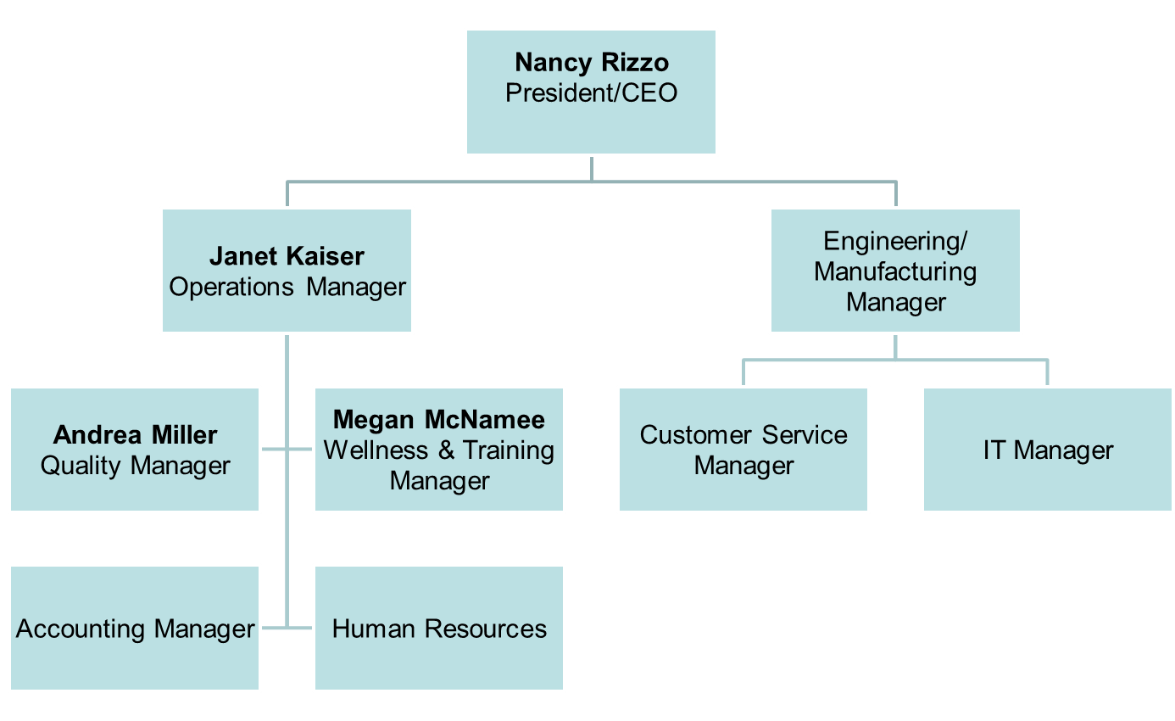
Management Team
EPIC Research and Diagnostics, Inc. Organization Confidential & Proprietary
Document Number: QA-012 Page 2
Version Number:000

Slide 3
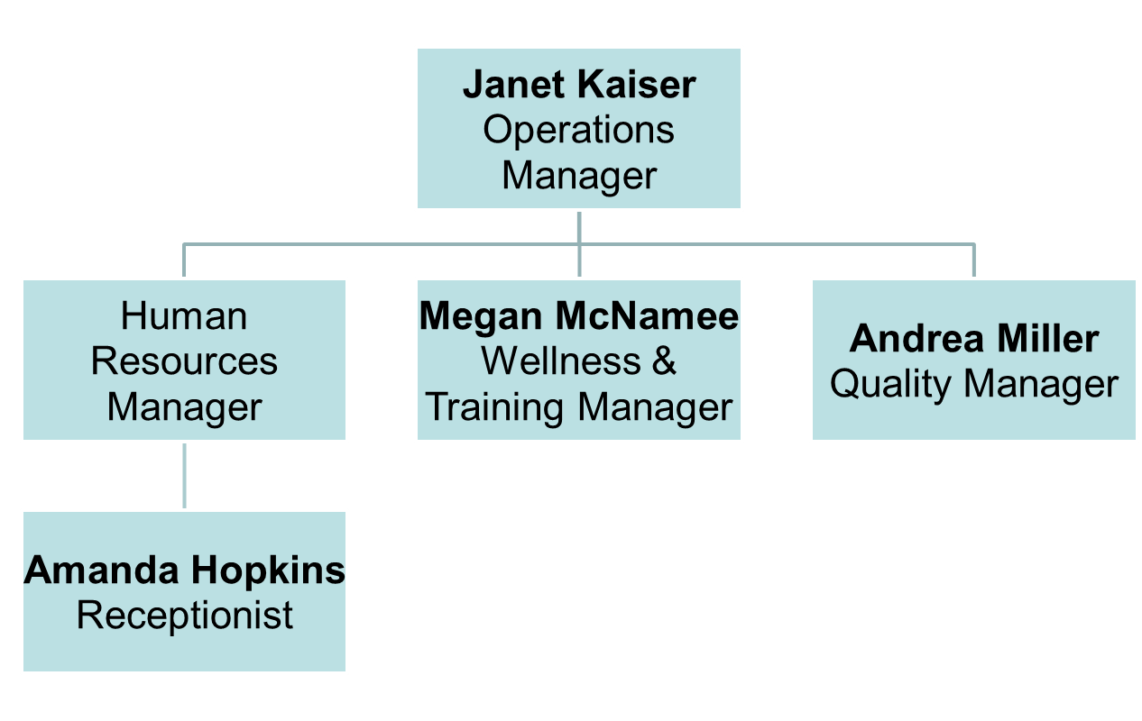
Operations Department
EPIC Research and Diagnostics, Inc. Organization Confidential & Proprietary
Document Number: QA-012 Page 3
Version Number:000

Slide 4
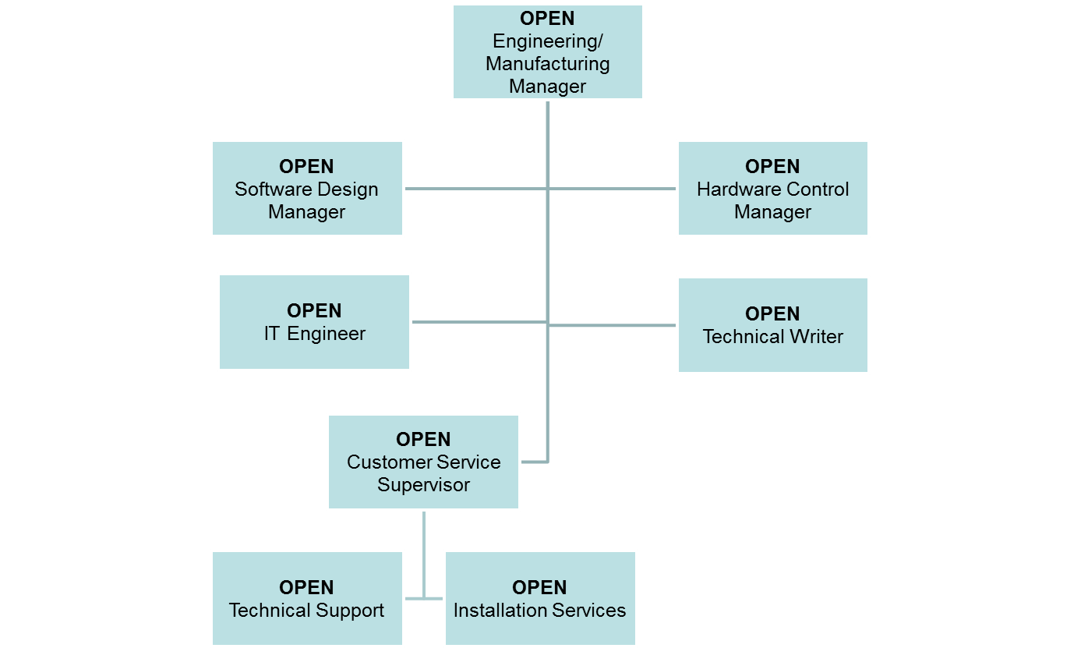
Engineering Manufacturing
EPIC Research and Diagnostics, Inc. Organization Confidential & Proprietary
Document Number: QA-012 Page 4
Version Number:000

Slide 5
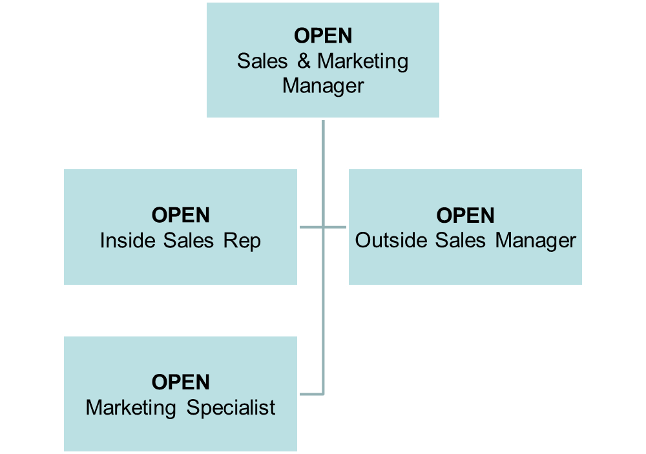
Sales/Marketing
EPIC Research and Diagnostics, Inc. Organization Confidential & Proprietary
Document Number: QA-012 Page 5
Version Number:000

Slide 6
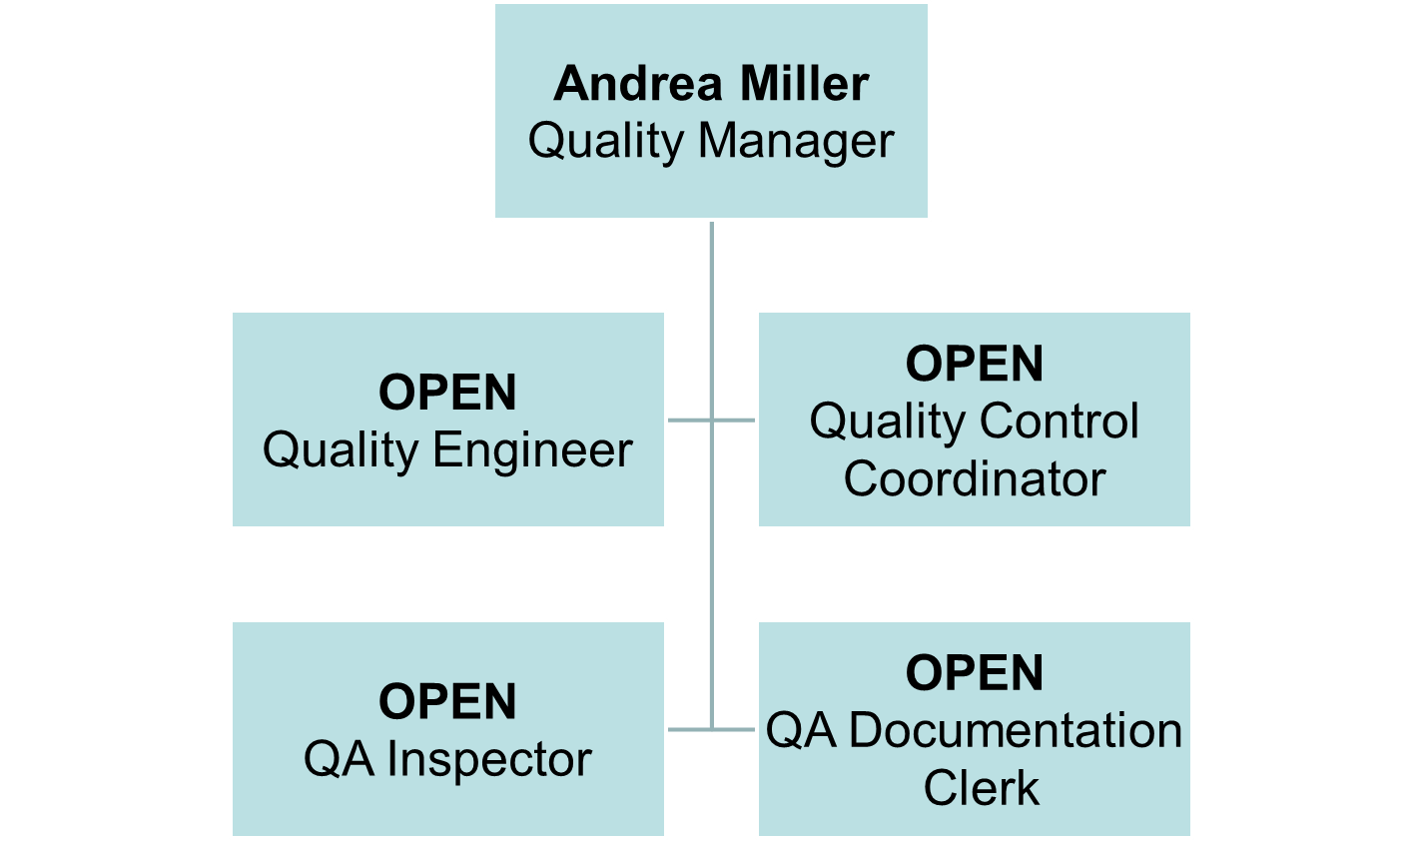
Quality Assurance
EPIC Research and Diagnostics, Inc. Organization Confidential & Proprietary
Document Number: QA-012 Page 6
Version Number:000

Slide 7
Organization
Chart
Document Revision History
Change Order Number: | Version Number: | Description of Change: | Date: | Updated by:
CC-091409-02 | 000 | New Document | 10/08/09 | AM
EPIC Research and Diagnostics, Inc. Organization Confidential & Proprietary
Document Number: QA-012 Page 7
Version Number:000

